Slide 1

Colorful
A feature by Chaim Javaheri, Ohad Eitan & Shai Tayar

Slide 2
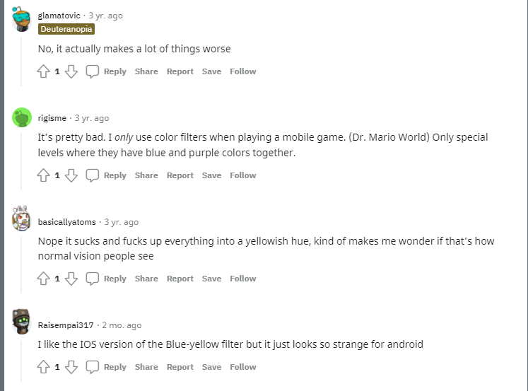
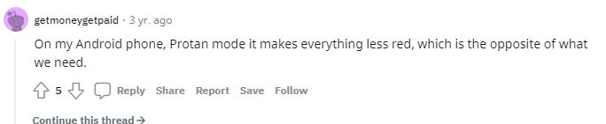
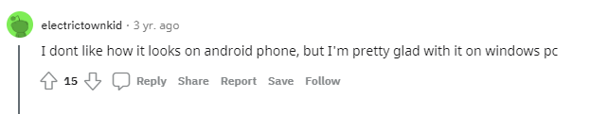

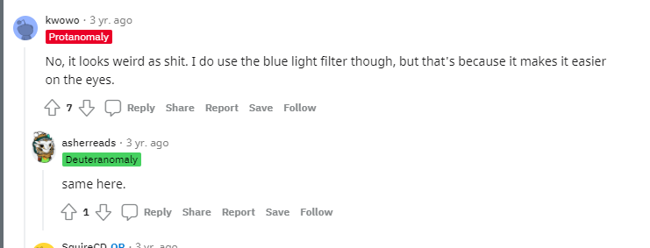
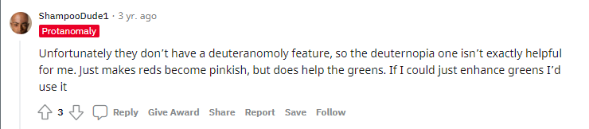


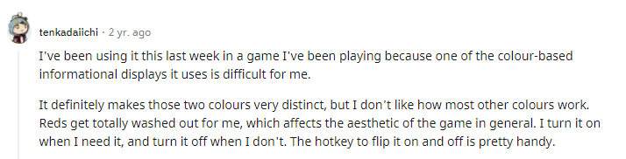
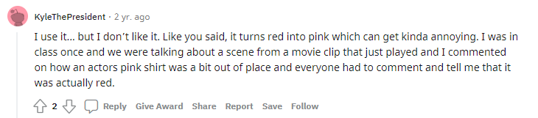
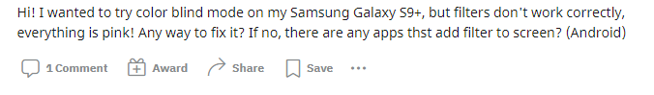
Many users claim default color filters in today’s devices aren't satisfying –
they lack personal customization
Notes:
https://www.reddit.com/r/ColorBlind/comments/cxczox/do_you_use_color_blind_mode_on_your_phone/
https://www.reddit.com/r/ColorBlind/comments/o4wmir/color_blind_mode_on_samsung/
https://www.reddit.com/r/ColorBlind/comments/bhgc6n/colorblind_mode_on_iphone/
https://www.reddit.com/r/ColorBlind/comments/ejhkg0/windows_10_colorblind_mode/
https://www.reddit.com/r/ColorBlind/comments/iqbm7n/just_discovered_colour_blind_mode_on_mac_im/

Slide 3
the Colorful Idea
A Personalized coloring filter for each color blind user
The feature will be integrated in the device’s system settings.
The feature will function as an addition to today’s devices default color filters.

Slide 4
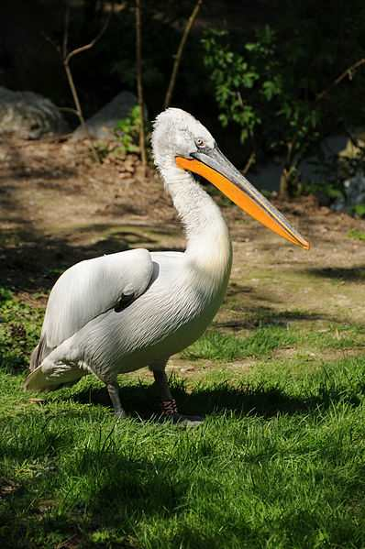

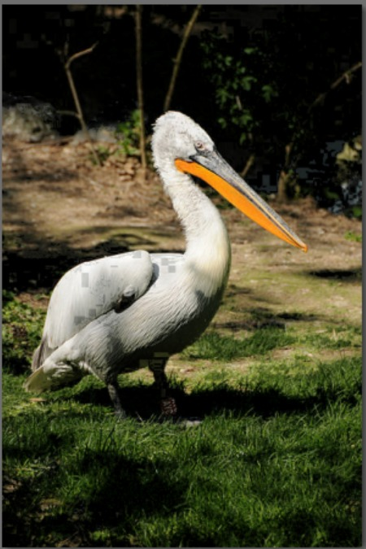
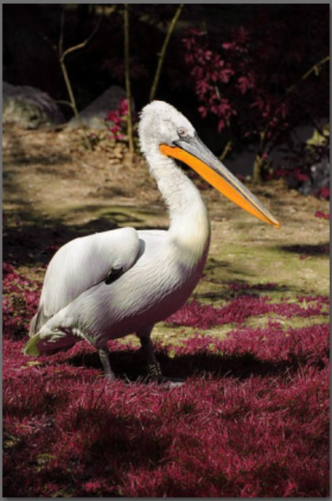
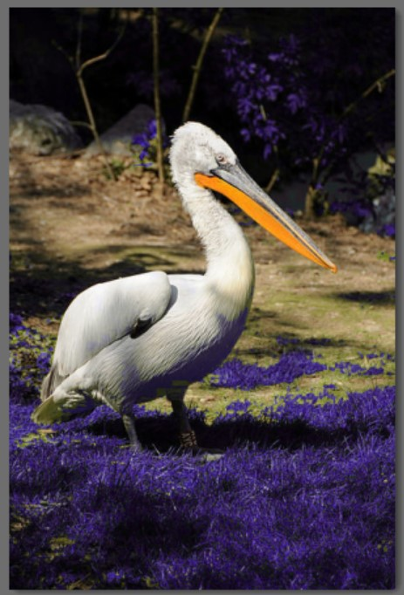
Colorful Demo at work
Shade Changing
Color Changing

Slide 5
Watch the Demo at work live!

